Slide 1
Normalization

Slide 2
Normalization
Normalization is the process of structuring the data in a table to minimize duplication and inconsistency.
You must understand the following terms before normalizing a database
Entity - represents an object about which you want to store the information
Attributes - represents the component of entity type or identifying qualities
Domain –defines the range for the attributes
Relationship - represents association between entities

Slide 3
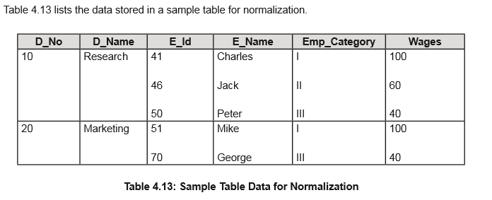
UnNormalization

Slide 4
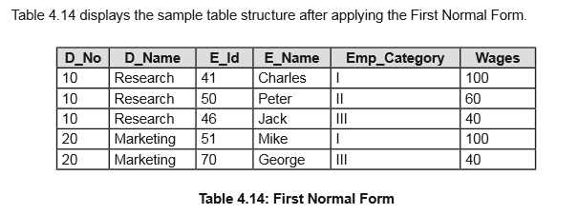
1NF
An entity is said to be in the first normal form, if all the attributes are single valued. In other words, there should not be any repeating attributes.

Slide 5
2NF
An entity is said to be in the second normal form, if it is in the first normal form and all non key attributes entirely depend on the unique identifier of the entity
After normalizing the sample table using the first normal form, the value for D_NO repeats several times. Also, the field D_NAME depends only on the D_NO field which is part of the primary key and not the entire primary key. Therefore, you will apply the second normal form and split the tables, as shown in tables.

Slide 6
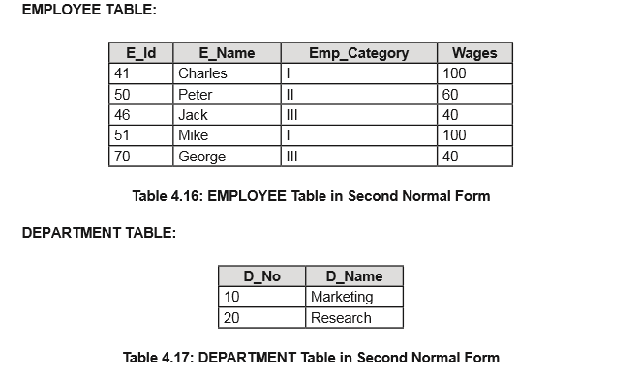
2NF

Slide 7
3NF
An entity is said to be in the third normal form, if it is already in the second normal form and no non-identifying attributes are dependent on any other non-identifying attributes.

Slide 8
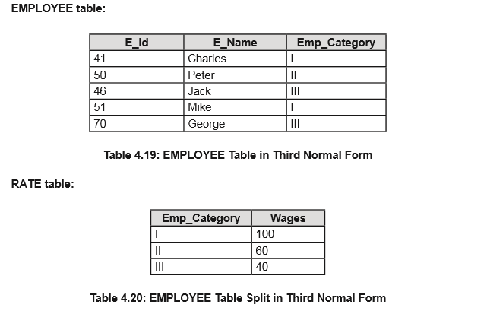

Slide 9
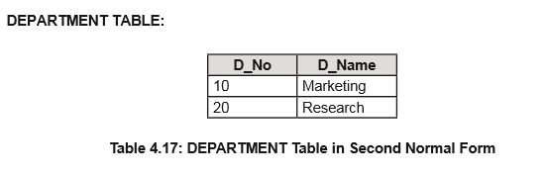
Final

Slide 10
Boyce-Codd Normal Form or BCNF
An entity is said to be in the Boyce-Codd normal form, if it is already in the third normal form and contains only one unique identifier.
The tables in the earlier example are already in the Boyce-Codd normal form.

Slide 11
Implementing SQL Queries Using MySQL
Describe the commands to view and alter a database.
Explain the commands to retrieve data from a table.
Describe the commands to modify the table definitions.
Describe the commands to delete the table definitions.

Slide 12
Viewing Information about Databases on the File System
SHOW DATABASES :
  SHOW –displays the object specified in the clause
  DATABASES – displays the databases present in the instance of MySQL
Like Clause:
  SHOW DATABASES [LIKE <condition>]; (general formate)
To view a list of tables in a database, use the following syntax:
  SHOW TABLES [FROM database_name] [LIKE <condition>];

Slide 13
Continue----------- book page no 140

